Slide 1
Constructing Feature Models Us­­ing a Cross-Join Merging Operator
Li Yi, APSEC ‘12

Slide 2
Outline
Introduction
Definition of the Merging Operator
Implementation of the Merging Operator
An Example
Related Work
Conclusions

Slide 3
Background: Feature Models
In software reuse, feature models (FMs) provide an effective way to organize and reuse software artifacts in specific domains.
FMs describe commonality and variability of the products in a domain.
Given an FM, products can be configured from the FM by selecting and deselecting the features
{Mobile Phone, Call, Screen, High Resolution, Media, Camera, MP3}.

Slide 4
Problem
It has been observed that the FM of a complex domain often contains thousands of features
With increasingly use of FMs in practice, the construction of FMs is becoming more and more complex for developers
One Possible Solution
Constructing a complex FM via merging of a set of simple FMs,
instead of constructing from scratch.

Slide 5
In this Paper
We define and implement an FM merging operator
Define Cross-Join Semantics: Output FM expresses all valid input product joined with all valid combination of unique features
Prove the correctness of implementation
Existing Semantics
Do not allow join
Do not ensure the validity of combination
Existing Implementations
No proof of correctness

Slide 6
Outline
Introduction
Definition of The Merging Operation
Implementation
An Example
Related Work

Slide 7
A Motivating Example
Merging two feature models
Input FM 1 | Input FM 2 | Output FM
Mobile phone with a SD or HD screen and 0, 1, or 2 of these modules: Wi-Fi 3G | Mobile phone with a touch or non-touch screen and 1 or 2 of these modules: Wi-Fi 3G | Mobile phone with a screen of two characteristics: SD or HD, and Touch or Non-Touch and 0, 1, or 2 of these modules: Wi-Fi 3G

Slide 8
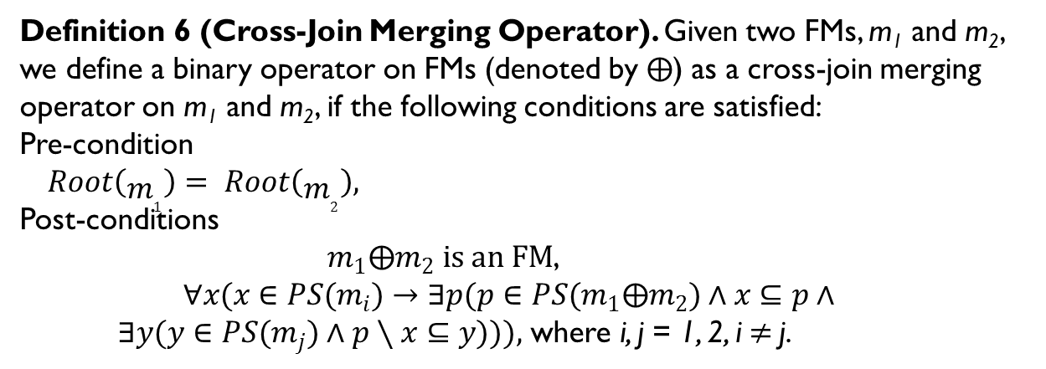
Definition of Cross-Join Semantics
Definition 6 (Cross-Join Merging Operator). Given two FMs, m₁ and m₂, we define a binary operator on FMs (denoted by$⨁$) as a cross-join merging operator on m₁ and m₂, if the following conditions are satisfied:
Pre-condition
$Root\left(m_{1}\right)= Root\left(m_{2}\right),$
Post-conditions
$m_{1}⨁m_{2} is an FM$,
$$∀x(x∈PS(m_{i})→∃p(p∈PS(m_{1}⨁m_{2})∧x⊆p∧$$ $∃y(y∈PS(m_{j})∧p∖x⊆y))),$ where i, j = 1, 2, i$≠$j.

Slide 9
Outline
Introduction
The Merging Operation
Requirements
Semantics
Algorithm
An Example
Related Work

Slide 10
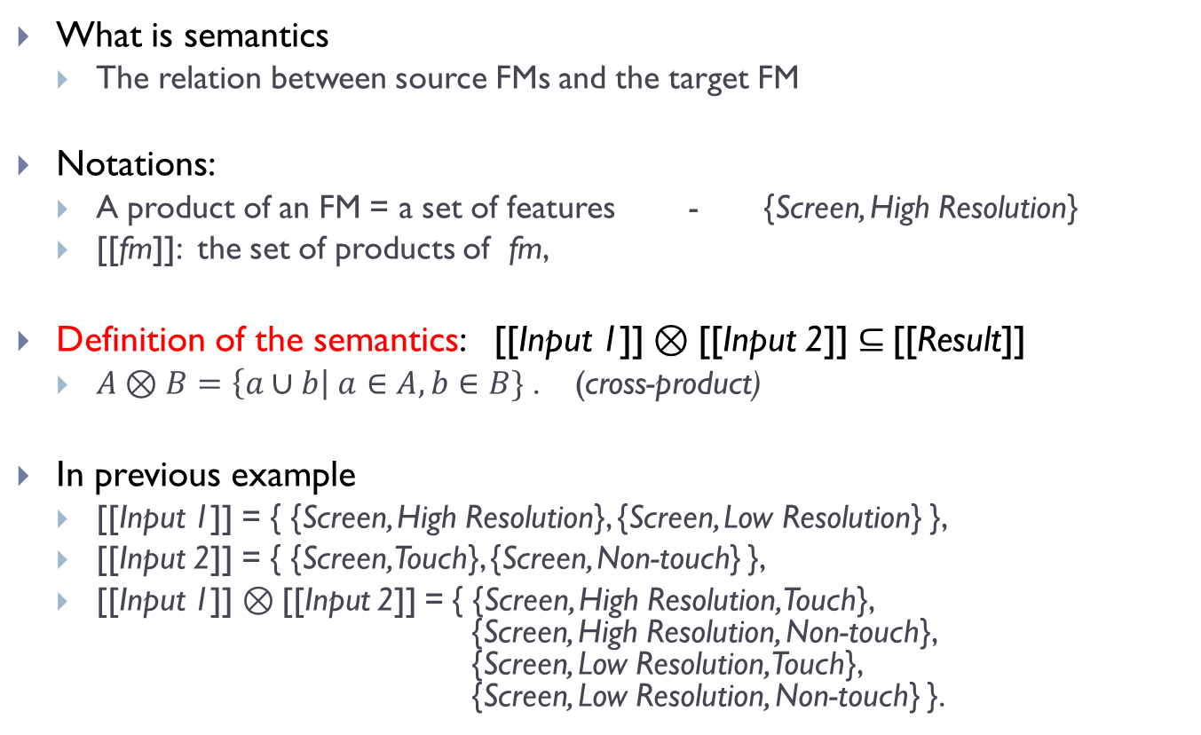
The Cross-product Semantics of Merging Operation
What is semantics
The relation between source FMs and the target FM
Notations:
A product of an FM = a set of features - {Screen, High Resolution}
[[fm]]: the set of products of fm,
Definition of the semantics: [[Input 1]]$⊗$[[Input 2]]$⊆$[[Result]]
$A⊗B=\left\{a∪b\right| a∈A, b∈B\}$ . (cross-product)
In previous example
[[Input 1]] = { {Screen, High Resolution}, {Screen, Low Resolution} },
[[Input 2]] = { {Screen, Touch}, {Screen, Non-touch} },
[[Input 1]]$⊗$[[Input 2]] = { {Screen, High Resolution, Touch}, {Screen, High Resolution, Non-touch}, {Screen, Low Resolution, Touch}, {Screen, Low Resolution, Non-touch} }.

Slide 11
Outline
Introduction
The Merging Operation
Requirements
Semantics
Algorithm
An Example
Related Work

Slide 12
Algorithm Overview
(With Named New Features)
Source FMs
Merging Rule Library
Target FM
Preprocessing
Merge Refinements
Merge Constraints
Post-processing
Source FMs
Target FM
Target FM
(With Rich-Refinement)
Tree Structure
Unnamed New Features
Tree Structure
Cross-Tree Constraints
Unnamed New Features

Slide 13
1. Preprocess the Source FMs
Generate rich-refinements
Rich: Variability + Semantics
Semantics of refinements (based on our previous work)
Decomposition
Specialization
Characterization
Car
Screen
House
XOR
Engine
Light
Basic
Touch
Area
Height
Whole-part refinement
(2 mandatory parts)
General-special refinement
(2 XOR specializations)
Entity-attribute refinement
(A mandatory & an optional attributes)

Slide 14
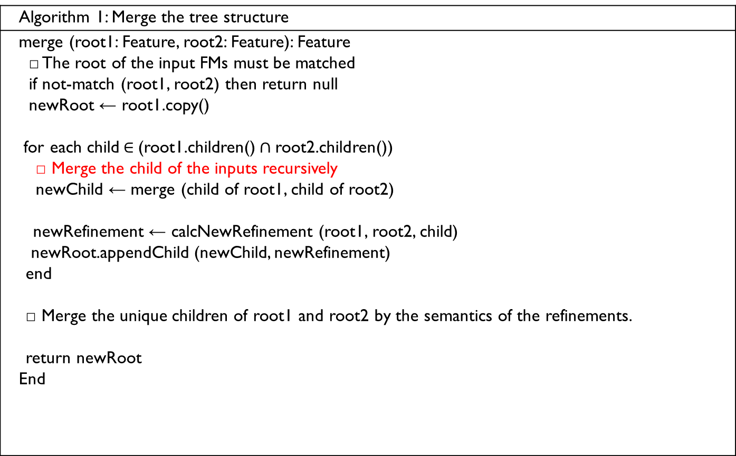
2. Recursively Merge Refinements
Algorithm 1: Merge the tree structure
merge (root1: Feature, root2: Feature): Feature □ The root of the input FMs must be matched if not-match (root1, root2) then return null newRoot ← root1.copy() for each child$∈$(root1.children()$∩$root2.children()) □ Merge the child of the inputs recursively newChild ← merge (child of root1, child of root2) newRefinement ← calcNewRefinement (root1, root2, child) newRoot.appendChild (newChild, newRefinement) end □ Merge the unique children of root1 and root2 by the semantics of the refinements. return newRoot End
New Root
New Root + Common Children
New Root + Common Children + Unique Children

Slide 15
2.1 Rules for Merging Unique Children (Sample)
Phone
Phone
Phone
Decomposition
+ Decomposition
= Decomposition
+
=
Calls
GPS
Screen
Media
Calls
Media
GPS
Screen
Specialization
+ Specialization
Screen
Screen
Screen
+
=
Resolution
Touch-ability
=
Specialized mandatory characteristics
HR
LR
Touch
Non-Touch
HR
LR
Touch
Non-Touch
Total: 7 rules

Slide 16
2.2 Rules for Merging Common Children (Sample)
Total: 10 rules
Based on Variability (Because no difference in Semantics)
 | Mandatory | Optional | Xor | Or
Mandatory | Mandatory | Mandatory | Mandatory | Mandatory
Optional |  | Optional | Or | Or
Xor |  |  | Xor | Or
Or |  |  |  | Or

Slide 17
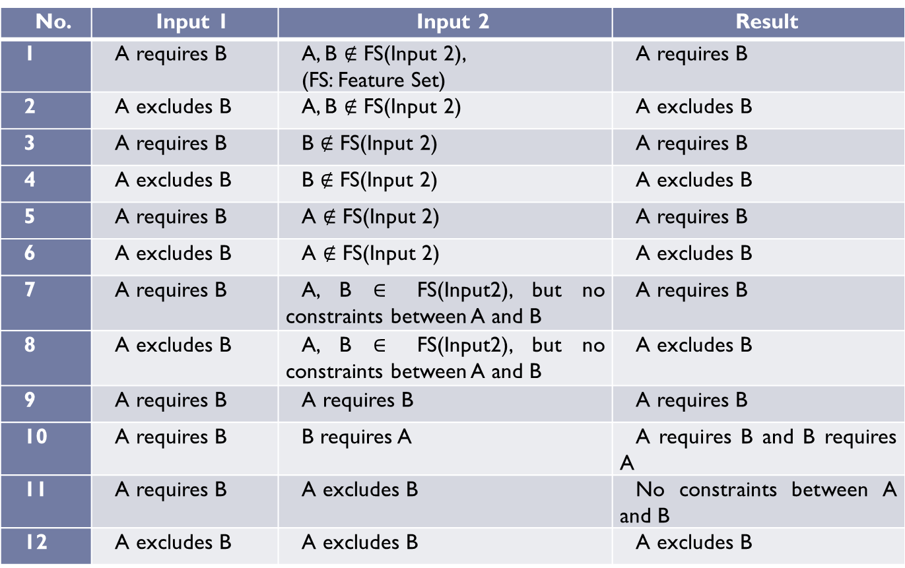
3. Merge (Binary) Constraints
Total: 12 rules
No. | Input 1 | Input 2 | Result
1 | A requires B | A, B $∉$ FS(Input 2), (FS: Feature Set) | A requires B
2 | A excludes B | A, B $∉$ FS(Input 2) | A excludes B
3 | A requires B | B $∉$ FS(Input 2) | A requires B
4 | A excludes B | B $∉$ FS(Input 2) | A excludes B
5 | A requires B | A $∉$ FS(Input 2) | A requires B
6 | A excludes B | A $∉$ FS(Input 2) | A excludes B
7 | A requires B | A, B $∈$ FS(Input2), but no constraints between A and B | A requires B
8 | A excludes B | A, B $∈$ FS(Input2), but no constraints between A and B | A excludes B
9 | A requires B | A requires B | A requires B
10 | A requires B | B requires A | A requires B and B requires A
11 | A requires B | A excludes B | No constraints between A and B
12 | A excludes B | A excludes B | A excludes B

Slide 18
4. Post-process the Target FM
FM developers should assign proper names for the attribute-features generated automatically in the merging of unique children
Screen
Screen
Screen
+
=
Attribute 1
Attribute 2
HR
LR
Touch
Non-Touch
HR
LR
Touch
Non-Touch
Screen
Resolution
Touch-ability
HR
LR
Touch
Non-Touch

Slide 19
Outline
Introduction
The Merging Operation
Requirements
Semantics
Algorithm
An Example
Related Work

Slide 20
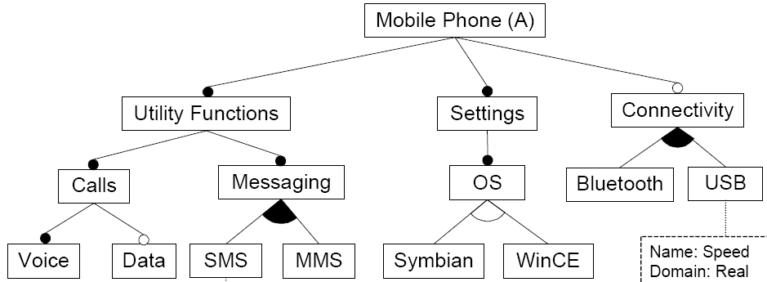
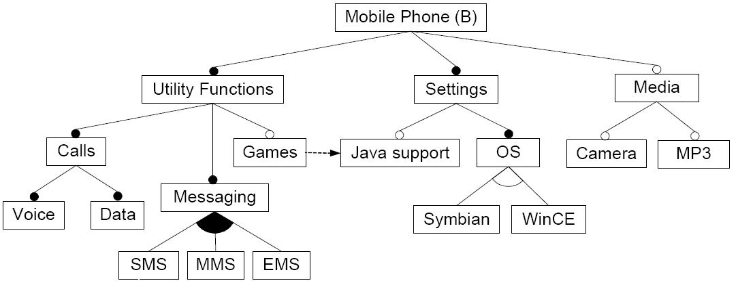
D
D
D
D
D
S
S
S
S
D
D
D
D
D
S
S
S
S

Slide 21
Mobile Phone
Connectivity
Utility Functions
Settings
Bluetooth
USB
Games
Java
OS
Calls
Messaging
Symbian
WinCE
Media
Voice
Data
SMS
MMS
EMS
Camera
MP3

Slide 22
Outline
Introduction
The Merging Operation
Requirements
Semantics
Algorithm
An Example
Related Work

Slide 23



Other Semantics of Merging Operation
Union
Intersection
[[Result]] $⊇$ [[Input1]] ∪ [[Input2]]
[[Result]] $=$[[Input1]] ∪ [[Input2]]
[[Result]] $=$[[Input1]] ∩ [[Input2]]
Comparison Example
FM
Products
Screen
Input 1
{Screen, LR},
{Screen, HR}
XOR
Low Resolution
High Resolution
Screen
Input 2
{Screen, Touch},
{Screen, Non-Touch}
XOR
Non-Touch
Touch

Slide 24
FM
Products
Union algorithm, answer A:
{Screen, Touch},
{Screen, Non-Touch},
{Screen, LR},
{Screen, HR}
Screen
XOR
Touch
Non-Touch
LR
HR
No Combination
Union algorithm, answer B:
{Screen, Touch, Non-Touch, HR},
{Screen, Touch, HR, LR},
…
Screen
Touch
Non-Touch
LR
HR
Violate Original Constraints
Intersection algorithm: (cut-off the unique features)
Screen
{Screen}
Missing Unique Features
None of these answers is desirable.

Slide 25
Other Merging Algorithms
Direct Mapping Algorithms
The input FMs can be directly mapped into a certain part of the output FM.
Quality of the output FM in their algorithms is not satisfying
Lots of redundancies (each common feature appears at least twice in the output FM)
The constraints between the features are not clear
Other Rule-based Algorithms
Some do not merge the cross-tree constraints
Their merging operation holds the union semantics, and it is not so suitable for the scenario described in this paper.
Logic-based Algorithms
Input → Logic Formulas → Output Logic Formula → Output
Much harder to implement
The computational complexity is exponential to the size of input FMs, while our algorithm is polynomial,
Transforming a logical formula to an FM gets a mal-structured FM

Slide 26
Conclusions and Future Work
In this paper, we propose an algorithm to merge feature models.
Our future work focuses on getting validation of scalability and usability of our merging operation
We plan to use the operation in our collaborative feature modeling environment. For example, synthesize multiple sub-trees which refine identical features.
…
BBS
Forum
BBS (Forum)
……
……
……

Slide 27
THANK YOU ! Q & A

